Slide 1
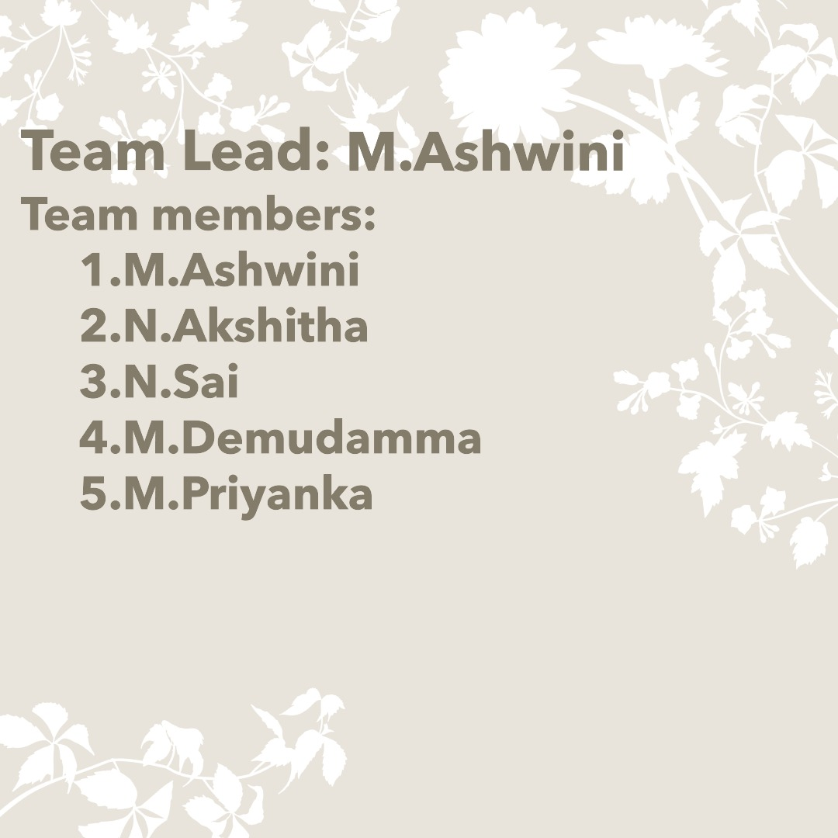

Slide 2


Slide 3
Content:
Brand Identity.
Competitor analysis.
Buyers personas.
Seo Audit.
Keyword research .
On-page optimization.
Content ideas generation & startergy.
Marketing strategies.
Poster making.
Social media campainings.
Email marketing.

Slide 4


Slide 5
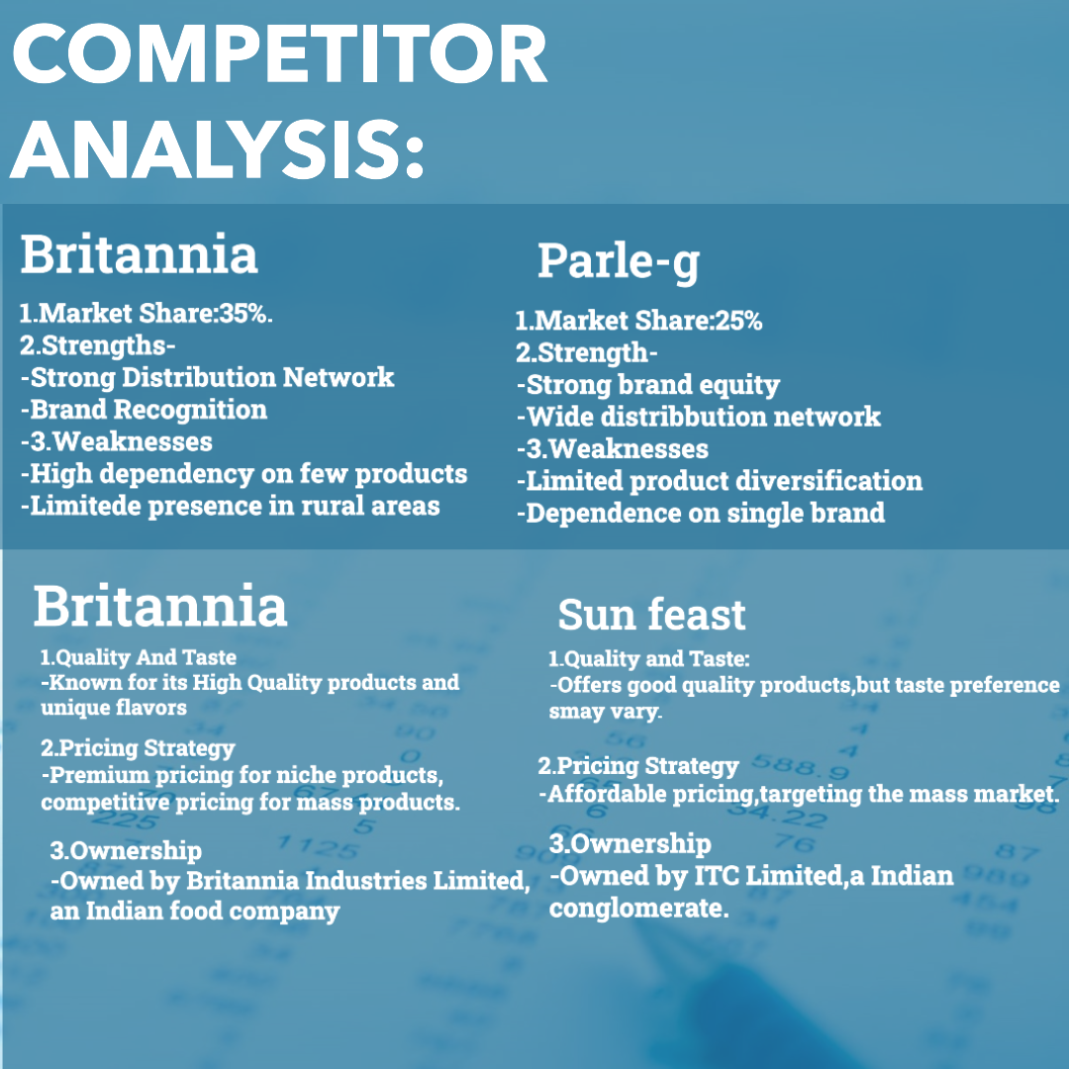

Slide 6
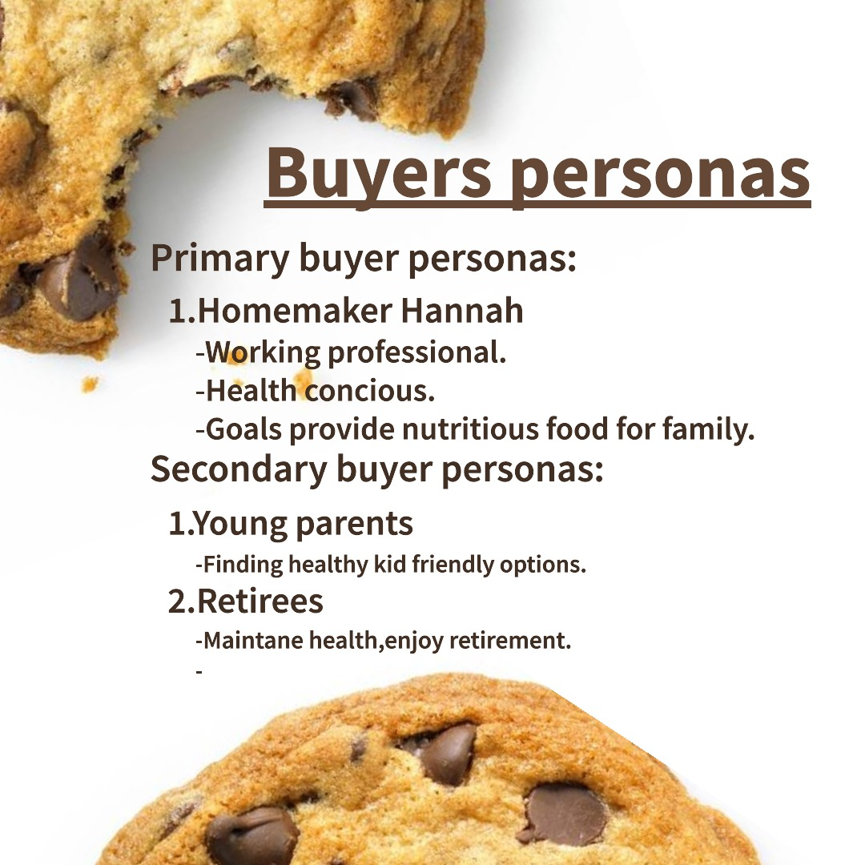

Slide 7
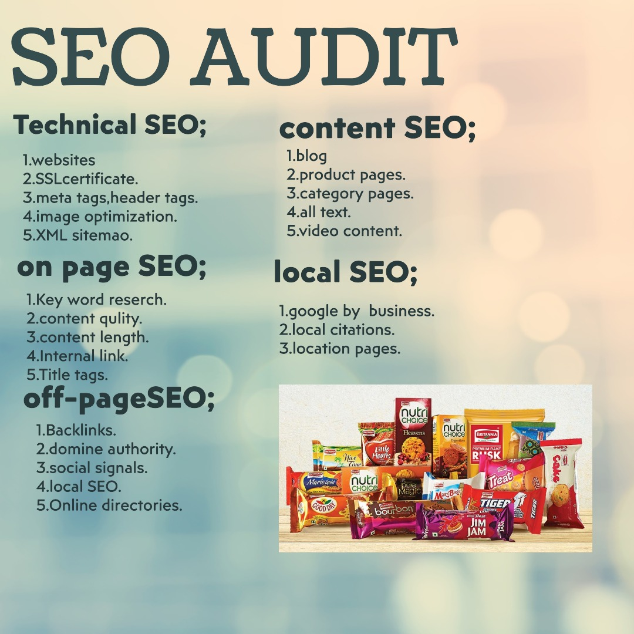

Slide 8

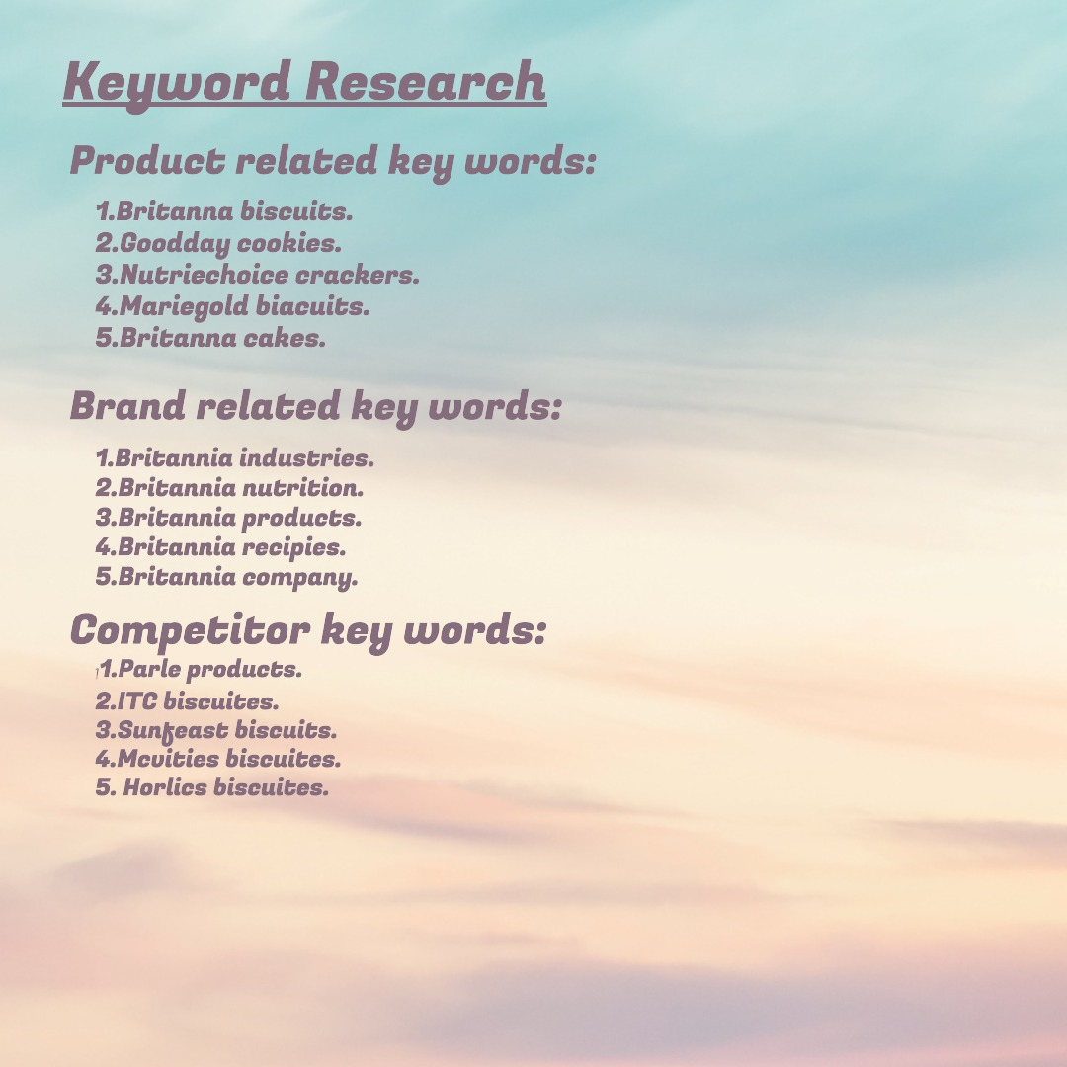



Slide 9
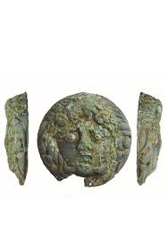
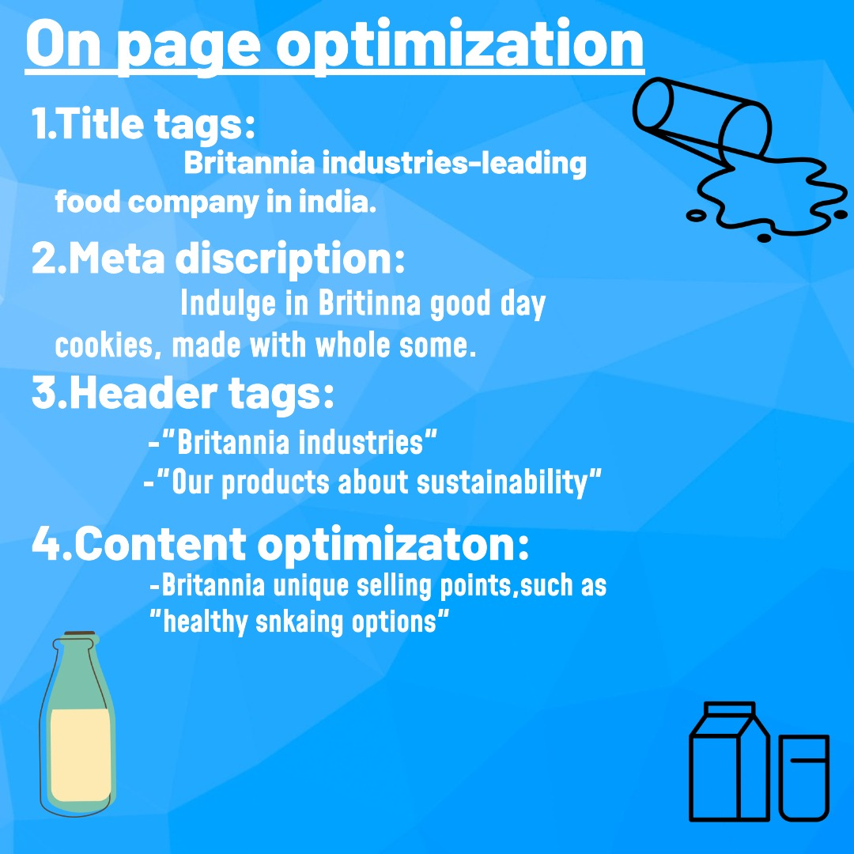
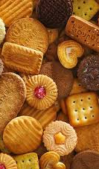

Slide 10
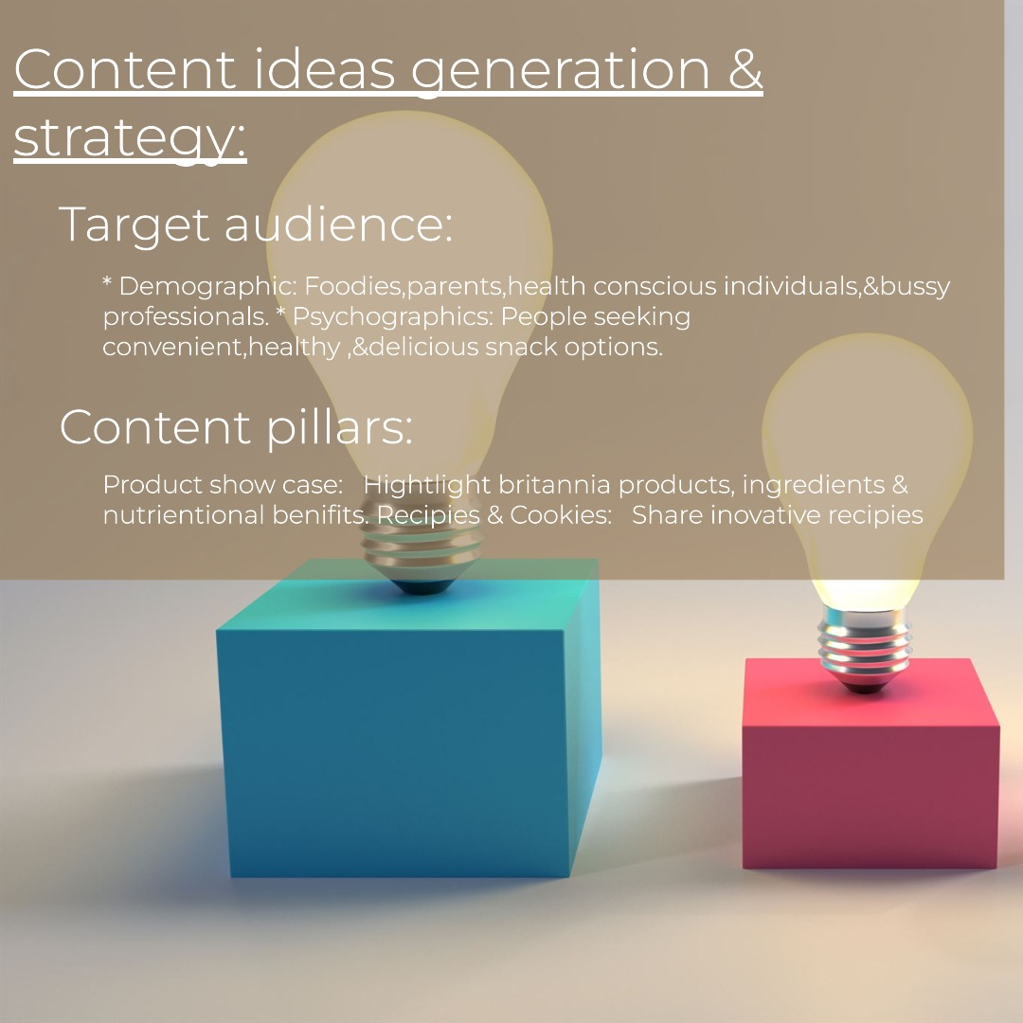

Slide 11
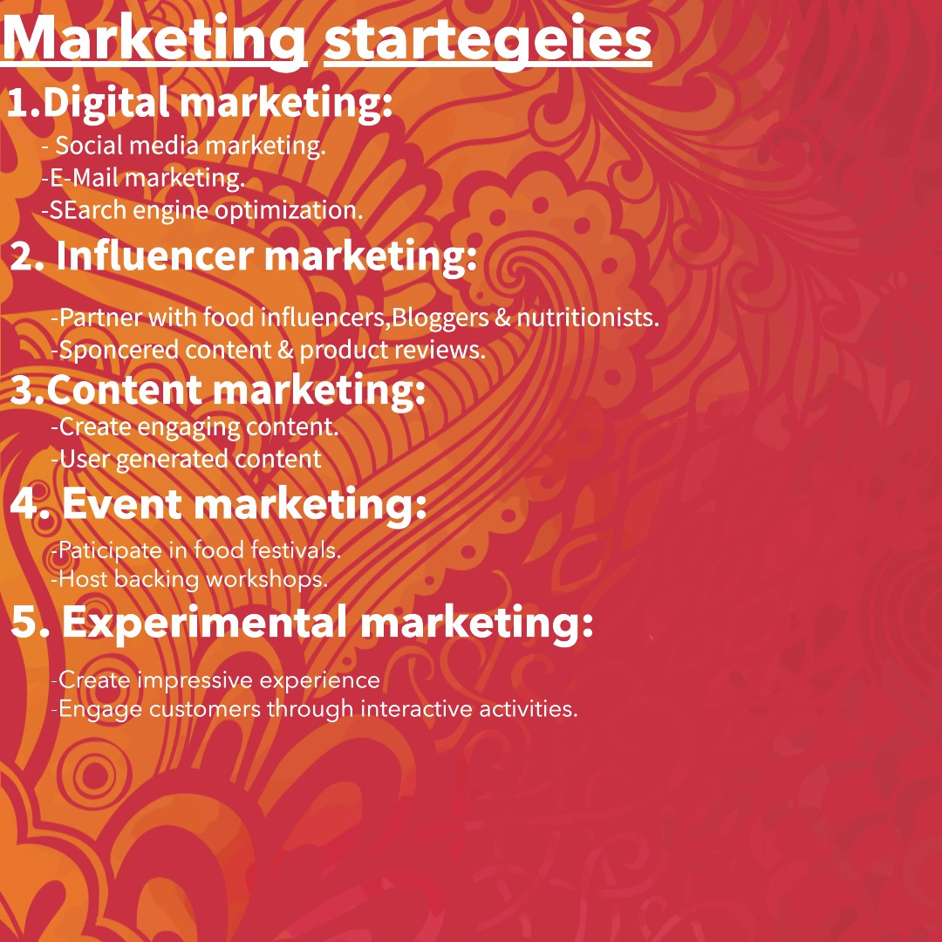

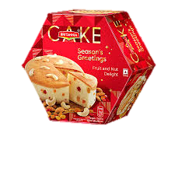
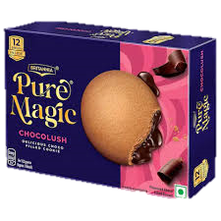

Slide 12
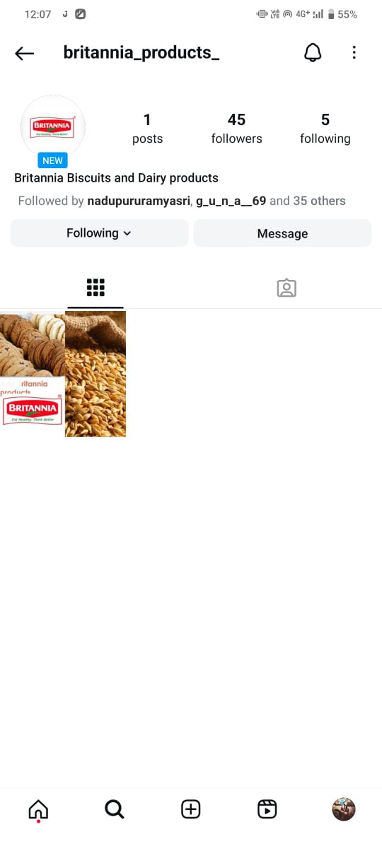

Video :- https://drive.google.com/file/d/1pJDtSObIG08wKQPPYqVtY0e1rNOjWzbH/view?usp=drivesdk

Slide 13
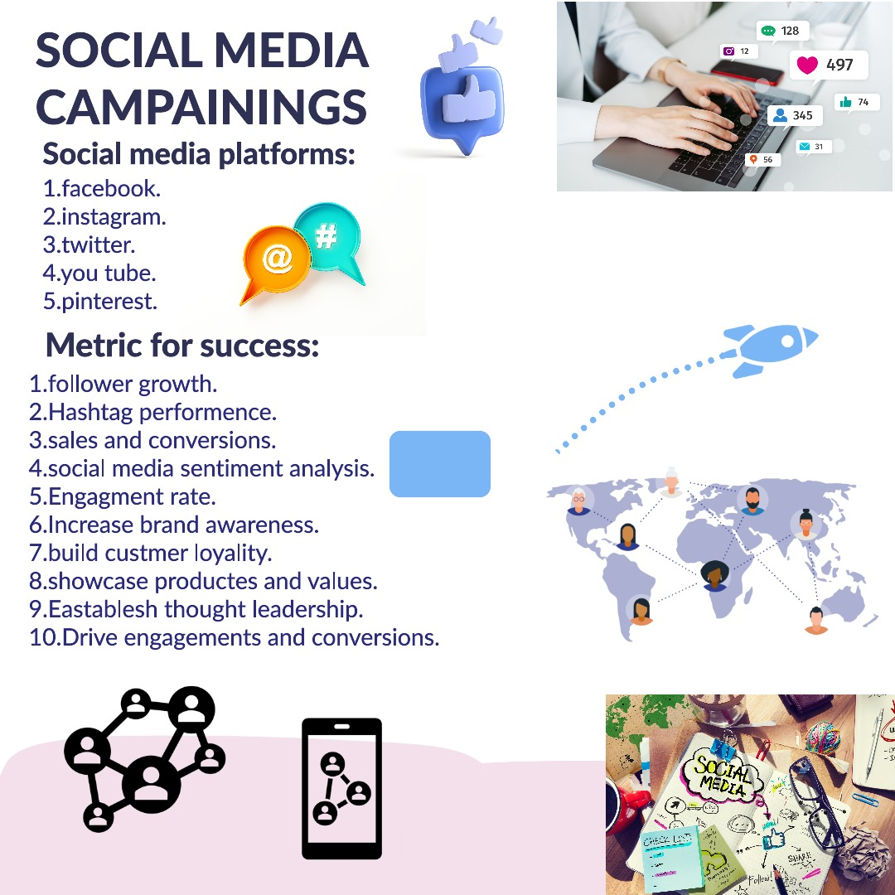

Slide 14
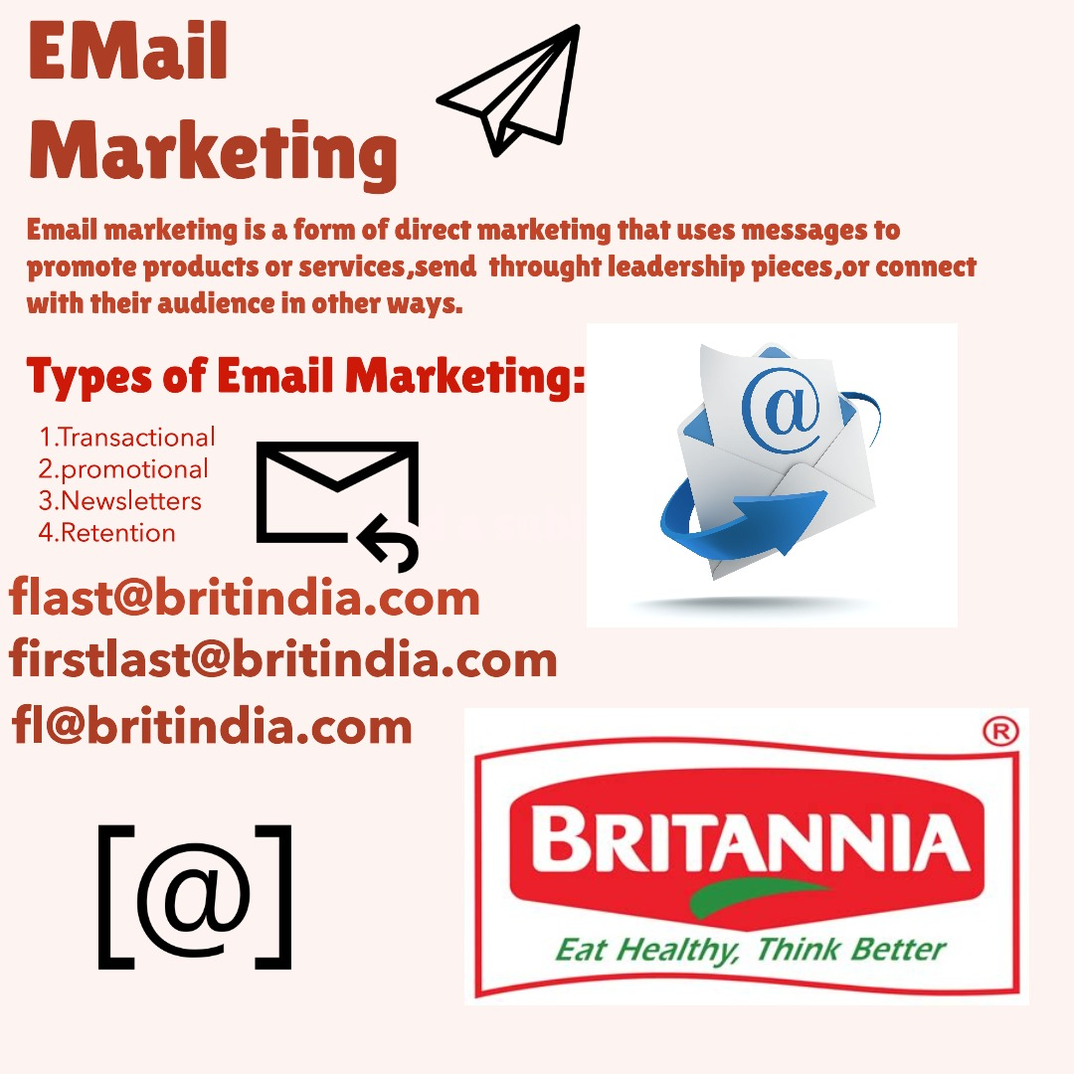

Slide 15


